Slide 1
FOOD
DONATION PLATFORM

Slide 2
GROUP MEMBERS
NAMES | MATRICULE
NDIKINTUM CARL NFON | FE20A073
NYENTY EYONG ARREHQUETTE | FE20A094
OBASIARREY M’ONEKE MARY ARREY-NJOK | FE20A095
OROCKTAKANG AGBORBEJA NTANGTANG | FE20A097
SALLE-NJUME MERYL EPOTE | FE20A102

Slide 3
TABLE OF CONTENTS
01
02
03
04
SYSTEM REQUIREMENT SPECIFICATIONS
ACTIVITY DIAGRAM
Here you could describe the topic of the section
USE CASE
SEQUENCE DIAGRAM
Here you could describe the topic of the section
Here you could describe the topic of the section

Slide 4
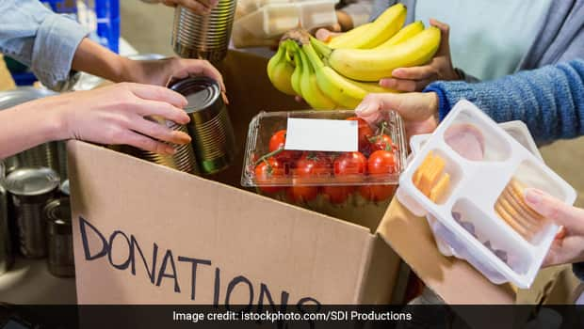
SYSTEM REQUIREMENTS SPECIFICATION
.

Slide 5
OUR COMPANY
USER MANAGEMENT
DONATION MANAGEMENT
TRACKING
Allows users to create and manage their accounts including personal info
Allows donors to donate food items including number of items, expiration date etc
Track donations with alerts sent to recipients when certain items are close to expiry.

Slide 6
LOCATION MANAGEMENT
SEARCH FUNCTION
Allows users to find the nearest donation locations, users, and items available for donation
Allow the creation and management of locations such as food banks, shelters, etc.
USER PERMISSIONS
Should allow different user roles and permissions with different levels of access to the system

Slide 7
REPORTING AND ANALYTICS
COMMUNICATION
FEEDBACK
Data should be collected about donation tracking
Allows users to provide feedback that can help improve the platform
Should have the ability to send notifications and alerts to users in real-time.

Slide 8
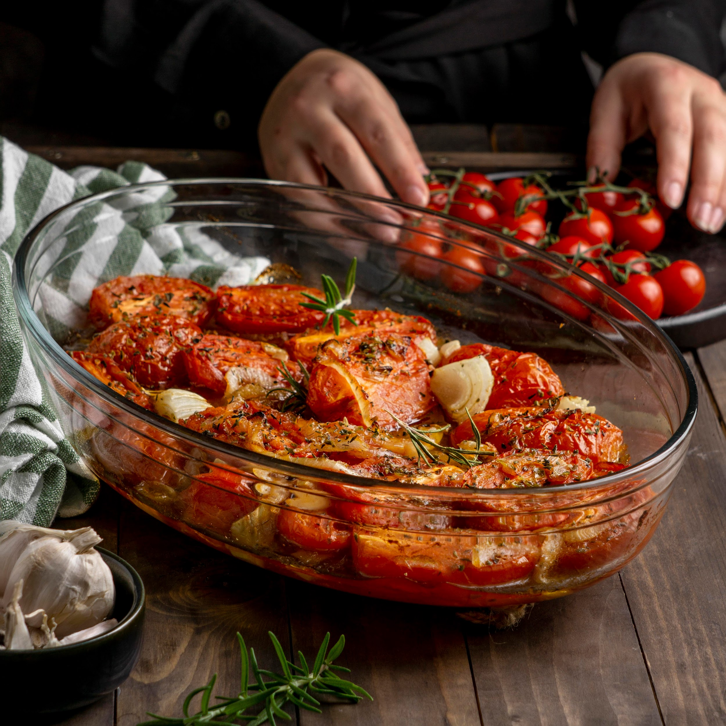
02
ACTIVITY DIAGRAM

Slide 9
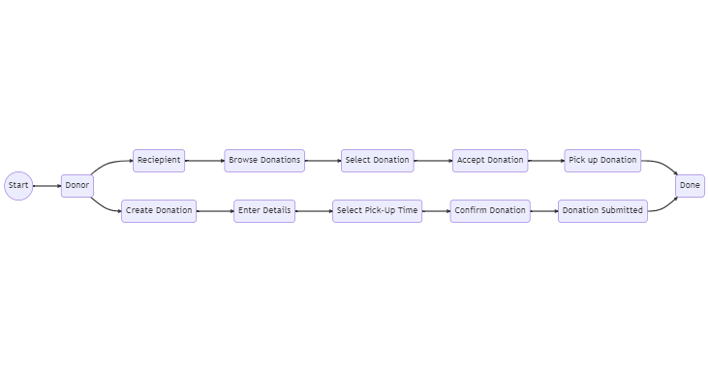

Slide 10
USE CASE DIAGRAM

Slide 11
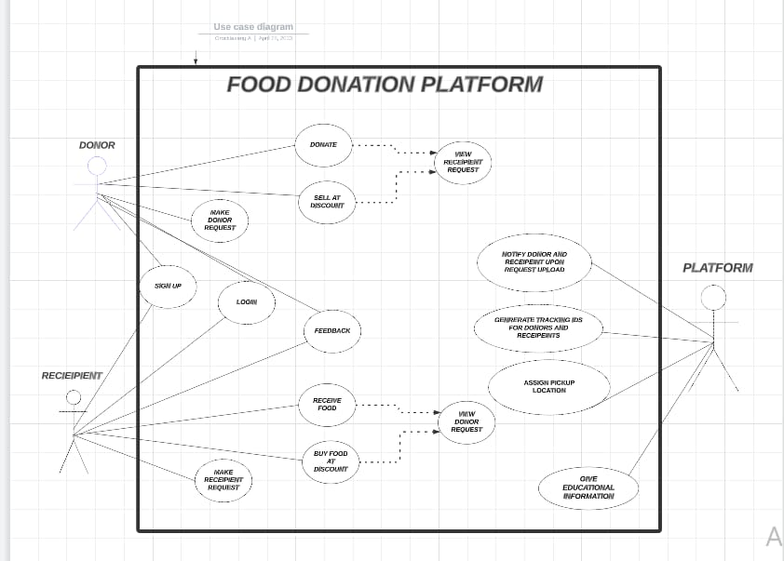

Slide 12
SEQUENCE DIAGRAMS

Slide 13
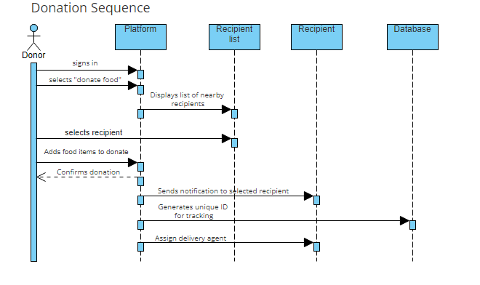

Slide 14
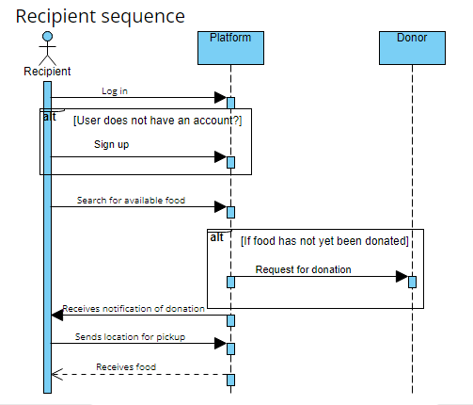

Slide 15
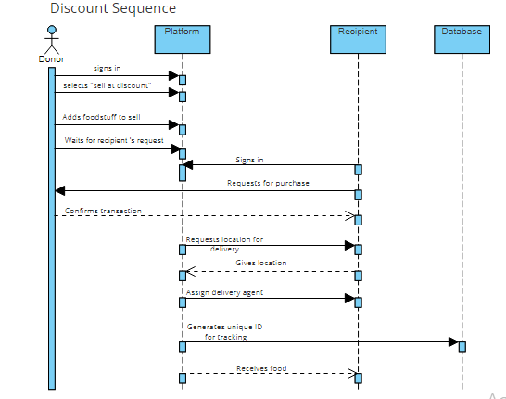

Slide 16
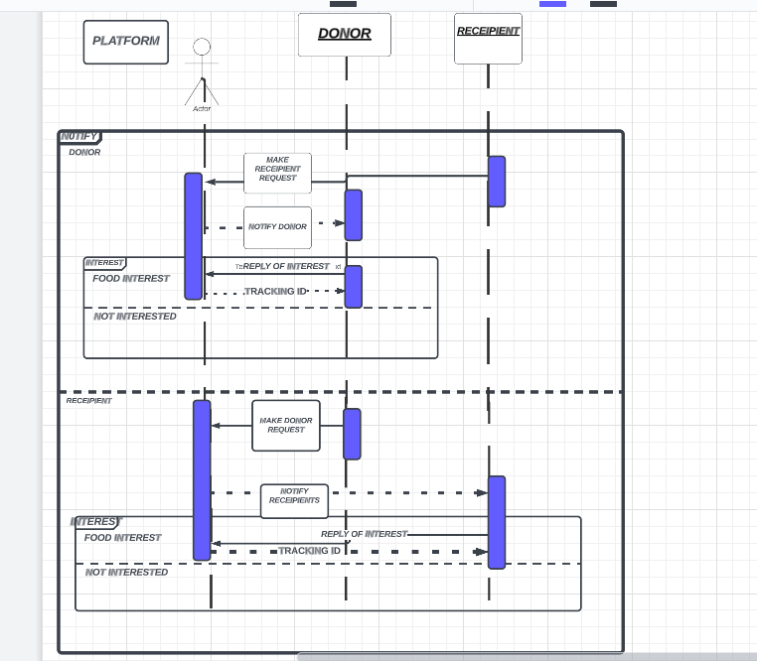

Slide 17
CLASS DIAGRAM

Slide 18
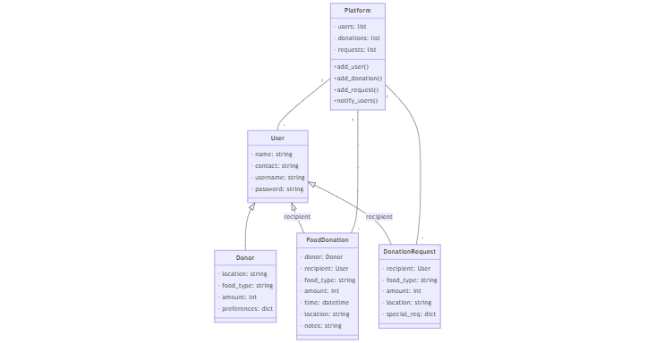

Slide 19
Thank you for your keen attention!!

